Slide 1

BitAuction A Blockchain-based Decentralized Auction System

Slide 2
BitAuction
Supervisors
Prof. Dr. Mohamed S. Abougabal
Prof. Dr. Shaimaa Lazem
Dr. Amira Alshazly
Team Members
Amr Ahmed
Fareeda Abouzeid
Joseph Shokry
Michael Monir
Mohamed Arous
Omar Tammam

Slide 3
Objectives
The importance of blockchain-based auction system.
Identify the scientific background of the project.
Discuss the challenges of the project.
Discuss the related work
Describe the scope of the project.

Slide 4
Agenda
What is a blockchain-based auction system?
Why build a blockchain-based auction system?
Background
Related work
Need to extend related work
Scope of work
Development Process, Environment and Tools
Implementation
Results
Future Work

Slide 5
Agenda
What is a blockchain-based auction system?
Why build a blockchain-based auction system?
Background
Related work
Need to extend related work
Scope of work
Development Process, Environment and Tools
Implementation
Results
Conclusion and Future Work

Slide 6
1. What is a blockchain-based auction system?
A blockchain-based auction system is a decentralized platform for buying and selling goods where biddings are conducted on a blockchain network.^{[1]}
This type of system leverages blockchain technology to ensure security, and trust among participants without requiring a central authority.^{[1]}

Slide 7
Agenda
What is a blockchain-based auction system?
Why build a blockchain-based auction system?
Background
Related work
Need to extend related work
Scope of work
Development Process, Environment and Tools
Implementation
Results
Conclusion and Future Work

Slide 8
2. Why build a blockchain-based auction system?
Auction systems have evolved from in-person settings to online platforms and now to blockchain-based environments, each step addressing issues of the previous.^{[1]}
Traditional auctions faced limitations in transparency, and high costs.^{[2]}

Slide 9
2. Why build a blockchain-based auction system? (Cont’d)
Online auctions expanded access and reduced costs but still relied on central authorities.^{[2]}
The decentralized nature of blockchain can provide a trustworthy, secure, and cost-effective mechanism to manage the auction process.^{[1]}

Slide 10
2. Why build a blockchain-based auction system? (Cont’d)
Blockchains give verifiability to auctions. Verifiability involves confirmation that the auction rules are followed.^{[3]}
Non-repudiation of bids once they are verified. This property is achieved by the immutable nature of the blockchain.^{[3]}
Global Accessibility with High Reliability: Participants from any part of the world can trust that their bids will be processed as per rules without fear of manipulation or downtime.^{[2]}

Slide 11
2.4 Do we need Blockchain?
Do you
need to store
state?
Are there
multiple
writers?
Can you
use an always
online TTP?
Are all
writers
known?
Yes
Yes
No
No
Permissionless
Blockchain
No
No
Yes
Yes
Public
Permissioned
Blockchain
Yes
Are all
writers
trusted?
Is public
verifiability
required?
No
Private
Permissioned
Blockchain
Yes
No
Don’t use
Blockchain
Fig. 1. A flow chart to determine whether to use Blockchain or not.^{[4]}

Slide 12
Agenda
What is a blockchain-based auction system
Why build a blockchain-based auction system
Background
Related work
Need to extend related work
Scope of work
Development Process, Environment and Tools
Implementation
Results
Conclusion and Future Work

Slide 13
3. Background
Auction Background
Auction Systems
Types of auctions

Slide 14
3. Background
Blockchain Background
Blockchain Technology
Consensus Mechanism
Types of Blockchains
Smart contracts

Slide 15
3.1.1 Auctions
An auction is a process of buying and selling goods or services.^{[2]}
This process involves offering items for bidding, waiting for bids to be accepted, and then selling goods to the highest bidder under the supervision of an auctioneer.^{[1]}

Slide 16

3.1.2 Auction Elements
Seller
Two or several bidders
Auction Objects
Auctioneer^{[1]}
Fig. 2. Auction Elements

Slide 17
3.1.3.1 Open-Outcry VS Sealed-Bid
From the Perspective of bidding process
Open-outcry: a bidder’s bidding activities are transparent and visible to all bidders^{[1]}
English Auction: open-outcry ascending-price auction^{[1]}

Slide 18
3.2.1 Blockchain Technology Overview^{[1][2]}
A decentralized, distributed ledger technology that securely records transactions across multiple nodes in a network. Each transaction is grouped into blocks and linked chronologically to form a “chain” of blocks.^{[1]}
How it works:
Transaction Creation: A transaction is initiated and broadcast to a peer-to-peer network.^{[2]}
Validation: Network nodes validate the transaction using consensus mechanisms like Proof of Work.^{[2]}
Block Formation: Verified transactions are grouped into a block and linked to the previous block, creating a chain.^{[2]}

Slide 19
3.2.3 Blockchain Consensus Mechanism^{[2]}
Protocols that ensure agreement on the state of the blockchain across distributed nodes without mutual trust. Importance: Critical for distributed ledgers' performance, integrity, and fault tolerance.
Common Approaches:
Proof of Work (PoW)
Proof of Stake (PoS)
Delegated Proof of Stake (DPoS)
Practical Bizantine Fault Tolerance (PBFT)

Slide 20
3.2.5 Blockchain Types
Permissioned Blockchain^{[1]}
Permissionless Blockchain^{[1]}
Hybrid Blockchain^{[1]}

Slide 21
3.2.5.1 Permissioned Blockchain
Closed system where access is restricted to authorized participants only.^{[1]}
Example: Hyperledger Fabric (HLF) (e.g., Fabric, Sawtooth).^{[1]}
Consensus Mechanism: Uses efficient algorithms like PBFT and Raft to identify malicious nodes.^{[1]}
Pros: Improved performance and security in controlled environments.^{[1]}
Cons: Partially decentralized, potentially reducing trust.^{[1]}

Slide 22
3.2.7 Smart Contracts^{[1][8]}
A smart contract is a tamper-proof, self-executing program running on the blockchain that automates and enforces business rules and logic agreed upon by participating entities.^{[8]}
These contracts automatically execute when pre-defined conditions are met, acting as software agents that ensure agreements are honored through the execution of secure code.^{[1]}

Slide 23
3.2.7 Smart Contracts
Beyond cryptocurrencies, smart contracts have extended to other blockchain platforms, such as chaincodes in Hyperledger Fabric and transaction processors in Sawtooth, allowing for diverse applications.^{[8]}

Slide 24
Agenda
What is a blockchain-based auction system?
Why build a blockchain-based auction system?
Background
Related work
Need to extend related work
Scope of work
Development Process, Environment and Tools
Implementation
Results
Conclusion and Future Work

Slide 25
4. Related Work
Related work (published papers)
Related work (Applications)

Slide 26
4.1 Related work (published papers) - 1
Papers | [1] | [2] | [3] | [6] | [8] | [9] | [10] | [11] | [12] | Ours
1. Year | 23 | 23 | 24 | 21 | 21 | 20 | 23 | 18 | 19 | 25
2. Q-level | Q1 | Q2 | Q2 | N/A | Q1 | Conf | Q2 | Q2 | Q1 | N/A
3. Software Model | N/A | N/A | N/A | N/A | N/A | N/A | N/A | N/A | N/A | SPI

Slide 27
4.1 Related work (published papers) - 2
Papers |  | [1] | [2] | [3] | [6] | [8] | [9] | [10] | [11] | [12] | Ours
4. Auction Model | English reverse | ✔ | ✔ | ✘ | ✘ | ✔ | ✘ | ✘ | ✘ | ✘ | ✘
 | Open-outcry | ✔ | ✔ | ✔ | ✘ | ✘ | ✘ | ✘ | ✘ | ✘ | ✔
 | Sealed-bid | ✔ | ✔ | ✘ | ✔ | ✘ | ✔ | ✔ | ✔ | ✘ | ✔
5. Secure |  | ✔ | ✔ | ✔ | ✔ | ✔ | ✔ | ✔ | ✔ | ✘ | ✔
6. Decentralized |  | ✔ | ✔ | ✘ | ✔ | ✔ | ✔ | ✔ | ✘ | ✘ | ✔

Slide 28
4.1 Related work (published papers) - 3
Papers | [1] | [2] | [3] | [6] | [8] | [9] | [10] | [11] | [12] | Ours
7. Smart Contracts | ✔ | ✔ | ✔ | ✔ | ✔ | ✔ | ✔ | ✔ | ✘ | ✔
8. Scalable | ✘ | ✘ | ✘ | ✘ | ✘ | ✘ | ✔ | ✘ | ✘ | ✔
9. Off-chain Calculations | ✘ | ✔ | ✘ | ✘ | ✘ | ✘ | ✔ | ✘ | ✘ | ✔
10. Rate of transactions | N/A | N/A | 500 TPS | 15 TPS | 15 TPS | N/A | 10k TPS | 15 TPS | N/A | N/A

Slide 29
4.1 Related work (published papers) - 4
Papers |  | [1] | [2] | [3] | [6] | [8] | [9] | [10] | [11] | [12] | Ours
11. Consensus Algorithm | PoW | ✔ | ✔ | ✘ | ✔ | ✔ | ✘ | N/A | ✔ | ✘ | ✘
 | PoS | ✔ | ✔ | ✘ | ✘ | ✘ | ✘ | N/A | ✘ | ✘ | ✘
 | DPoS | ✔ | ✔ | ✘ | ✘ | ✘ | ✘ | N/A | ✘ | ✘ | ✘
 | PBFT | ✔ | ✔ | ✘ | ✘ | ✘ | ✔ | N/A | ✘ | ✘ | ✘
 | Raft | ✘ | ✘ | ✔ | ✘ | ✘ | ✘ | N/A | ✘ | ✘ | ✔

Slide 30
4.1 Related work (published papers) - 6
Papers |  | [1] | [2] | [3] | [6] | [8] | [9] | [10] | [11] | [12] | Ours
12. Blockchain Type | Permissionless | ✔ | ✔ | ✘ | ✔ | ✔ | ✘ | ✘ | ✔ | ✘ | ✘
 | Permissioned | ✔ | ✔ | ✔ | ✘ | ✘ | ✔ | ✔ | ✘ | ✘ | ✔
 | Bitcoin | ✘ | ✔ | ✘ | ✘ | N/A | N/A | N/A | ✘ | ✘ | ✘
 | Ethereum | ✔ | ✔ | ✘ | ✔ | N/A | N/A | N/A | ✔ | ✘ | ✘
 | HLF | ✘ | ✘ | ✔ | ✘ | N/A | N/A | N/A | ✘ | ✘ | ✔

Slide 31
4.1 Related work (published papers) - 7
Papers | [1] | [2] | [3] | [6] | [8] | [9] | [10] | [11] | [12] | Ours
13. Mixing privacy Service | ✔ | ✘ | ✘ | ✘ | ✘ | ✘ | ✘ | ✘ | ✘ | ✘
14. Hybrid Blockchain | ✔ | ✔ | ✘ | ✘ | ✘ | ✘ | ✔ | ✘ | ✘ | ✘
15. Ordering & Fairness | ✘ | ✔ | ✔ | ✔ | N/A | ✔ | ✔ | ✔ | ✘ | ✔
16. Smart contract update | ✔ | ✘ | ✘ | ✘ | ✘ | ✘ | ✘ | ✘ | ✘ | ✘

Slide 32
4.1 Related work (published papers) - 8
Papers | [1] | [2] | [3] | [6] | [8] | [9] | [10] | [11] | [12] | Ours
17. Payment with Cryptocurrency | ✘ | ✔ | ✘ | ✔ | ✘ | ✘ | N/A | ✔ | ✘ | ✔
18. Energy Efficient Consensus Models | ✘ | ✔ | ✔ | ✘ | ✘ | ✘ | N/A | ✘ | ✘ | ✔
19. Initial Price Prediction Support | ✘ | ✘ | ✘ | ✘ | ✘ | ✘ | ✘ | ✘ | ✔ | ✘
20. Personalized recommendations | ✘ | ✘ | ✘ | ✘ | ✘ | ✘ | ✘ | ✘ | ✔ | ✘

Slide 33
4.2 Related work (Applications) - 1
Auctions | [13] | [14] | [15] | [16] | [17] | Ours
1. Open source | ✔ | ✘ | ✘ | ✔ | ✘ | ✔
2. Year | 2022 | 2017 | 2020 | 2020 | 2002 | 2025
3. License | Apache2.0 | MIT | N/A | Apache 2.0 | N/A | MIT
4. Source code availability | ✔ | ✔ | ✘ | ✔ | ✘ | ✔

Slide 34
4.2 Related work (Applications) - 2
Auctions / features | [13] | [14] | [15] | [16] | [17] | Ours
5. Support Blockchain | ✔ | ✔ | ✔ | ✔ | ✘ | ✔
6. Language | JS | TS | TS & JS | Go | N/A | Go & JS
7. Front framework | React | N/A | React | N/A | N/A | React
8. Backend framework | Reach | N/A | N/A | N/A | N/A | NestJs

Slide 35
4.2 Related work (Applications) - 3
Auctions / features |  | [13] | [14] | [15] | [16] | [17] | Ours
9. Support off chain |  | ✘ | ✔ | N/A | ✔ | ✔ | ✘
10. Auction model | Open-outcry | ✔ | ✔ | ✔ | ✔ | ✔ | ✔
 | Sealed bid | ✔ | ✘ | ✘ | ✘ | ✘ | ✘
11. Support anonymity |  | ✔ | N/A | N/A | N/A | ✘ | ✘

Slide 36
4.2 Related work (Applications) - 4
Auctions / features | [13] | [14] | [15] | [16] | [17] | Ours
12. Most common Cryptocurrency type | ETH, Algo | ETH | ETH | STARS | N/A | N/A
13. Generic auction objects | ✘ | ✘ | ✘ | ✘ | ✔ | ✔
14. Blockchain technology | Algorand | Solidity | Solidity | cosmwasm | N/A | HLF

Slide 37
4.2 Related work (Applications) - 5
Auctions / features | [13] | [14] | [15] | [16] | [17] | Ours
15. Live Auctions | ✘ | ✔ | NA | ✔ | ✔ | ✔

Slide 38
Agenda
What is a blockchain-based auction system?
Why build a blockchain-based auction system?
Background
Related work
Need to extend related work
Scope of work
Development Process, Environment and Tools
Implementation
Results
Conclusion and Future Work

Slide 39
5. Need to extend related work
A close study of tables 4.1 & 4.2 suggests the need for
the following extensions of related work:
Open-Source Development.^{[3]} (4.2.1)
Development using the SPI model. (4.1.3)
Support for Open-outcry auction format.^{[3]} (4.1.4)
Integrate with Hyperledger.^{[3] [8]} (4.1.6, 4.1.12)
Auction privacy protection.^{[1]} (4.1.13)
Transaction ordering and fairness.^{[1]} (4.1.15)

Slide 40
5. Need to extend related work (Contd.)
A close study of tables 4.1 & 4.2 suggests the need for
the following extensions of related work:
Smart Contract update.^{[1]} (4.1.16)
8. Auction payment with cryptocurrency.^{[1]} (4.1.17)
9. Multi-Chain compatibility.^{[8]}
10. Auction scalability solutions.^{[6]} (4.1.8)
11. Off-Chain data handling.^{[18]} (4.1.9)
12. Integration with oracles for real world data.^{[8]}

Slide 41
5. Need to extend related work (Contd.)
A close study of tables 4.1 & 4.2 suggests the need for the following extensions of related work:
13. Conduct evaluation for the system.^{[3]}
14. Use FastFabric as an underlying system.^{[19]}
15. Support dynamic live auction interface. (4.2.15)
16. Support personalized recommendations.^{[12]} (4.1.19)
17. Price prediction on auction items.^{[12]} (4.1.19)
18. Develop auction user-friendly interface.

Slide 42
5.1 Open-Source Development^{[3]}
Develop an open-source blockchain-based auction platform to foster community contributions, addressing the limited availability of open-source projects.
Publish code on GitHub.
Ensure proper documentation and licensing for transparent and widespread usage.

Slide 43
5.2 Development using the SPI model
Utilize the SPI model for flexible system integration and expansion.
Documentation using SPI Model including detailed report, well commented code, and references.

Slide 44
5.3 Support for Open-outcry auction^{[3]}
Implement real-time, open-outcry auction capabilities for transparent and competitive bidding.
The current literature on Open-outcry auctions is limited compared to sealed approaches.^{[3]}
This is due to the difficulty of time synchronization.^{[3]}

Slide 45
5.4 Integrate with Hyperledger^{[3][8]}
Utilize Hyperledger as a blockchain solution for the auction system, leveraging its modular framework which allow us to customize the blockchain network to meet the specific requirements of our auction platform.^{[3]}
Although most research papers utilize Ethereum smart contracts, Hyperledger is more suitable for our case due to its enhanced privacy features and higher transaction throughput.

Slide 46
5.5 Auction privacy protection^{[1]}
Utilize Mixing Services that prevents users' addresses from being linked to their real identities, but the mixing function is handled centrally.^{[1]}
Use of Permissioned Blockchains where nodes within the same channel can share data, but nodes outside of this channel cannot access it.^{[1]}

Slide 47
5.6 Transaction ordering & fairness^{[3]}
Permissionless blockchains use PoW-based consensus algorithms to determine the order of transactions and avoid double spending. But it introduces uncertainty to the users.^{[1]}
Design an efficient transaction ordering system to maintain integrity as proposed in paper [3].

Slide 48
5.7 Smart Contract update^{[1]}
All code and data are immutable and maintained by decentralized nodes. It is impossible to make changes to the original smart contract.^{[1]}
When bugs occur in the application, redeployment is costly and can seriously damage the application’s reputation, leading to a crisis of trust.^{[1]}
To solve this, researchers suggest using proxy contract mechanisms. OpenZippelin^{[20]} provides a range of libraries to handle proxy logic.

Slide 49
5.8 Auction payment with cryptocurrency^{[1]}
The price volatility of cryptocurrencies is a big challenge in which their market values are constantly fluctuating.
Users will be hesitant to use cryptocurrencies as the sole payment method, but price prediction models can be used to help mitigate this issue.^{[1]}
Implement cryptocurrency payment gateways to allow seamless transactions during the auction.

Slide 50
5.9 Multi-Chain compatibility^{[8]}
A multi-chain auction framework would allow users to participate in auctions across different blockchain ecosystems, which would facilitate broader asset availability, greater user participation, and more seamless liquidity flows across networks.^{[8]}
This minimizes congestion and prevents one large or complex auction from slowing down the entire system.

Slide 51
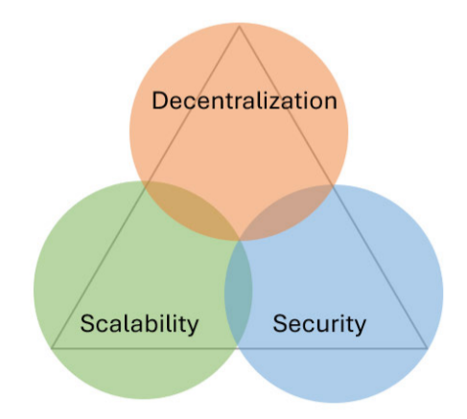
5.10 Auction scalability solutions^{[6]}
The blockchain trilemma concept argues that a blockchain system cannot support the following three operations.^{[2]}
Balancing decentralization, scalability, and security. Typically, only two can be maximized.
We aim to lose some decentralization for the sake of scalability
Fig. 6. The blockchain trilemma

Slide 52
5.11 Off-Chain data handling^{[8]}
Off-chain data handling involves storing large data sets outside the blockchain to reduce transaction costs and improve scalability.^{[8]}
Utilize InterPlanetary File System (IPFS) which is a decentralized, reliable, and cost-effective storage.^{[8]}
Linking the blockchain to off-chain data via cryptographic hashes. This ensures data integrity.

Slide 53
5.12 Integration with an oracle^{[8]}
Implement integration with decentralized oracles to bring off-chain, real-world data into the blockchain-based auction system allowing the auction system to incorporate real-time data.^{[8]}
The implementation will build on concepts from papers like [8], where oracles are used to bridge the gap between the blockchain and real-world data.

Slide 54
5.13 Conduct evaluation for the system^{[3]}
Evaluate the performance of the blockchain layer, focusing on transaction throughput, latency, and gas costs under varying levels of user activity.
Assess the application's overall performance, including response times, resource utilization, and scalability, to ensure smooth user experiences during high-load scenarios.

Slide 55
5.14 Use FastFabric as an underlying system^{[19]}
Build the auction system on Hyperledger Fabric or FastFabric for secure, permissioned blockchain infrastructure.
FastFabric supports up to 20,000 transactions per second, making it an ideal choice for the auction system, where a high volume of transactions needs to be processed quickly and efficiently.^{[19]}

Slide 56
5.15 Support dynamic live auction
Live auction support is an essential feature for modern auction platforms. It allows users to participate in real-time bidding, enhancing engagement and excitement.
Ensure the live auction interface is optimized for low-latency, real-time updates to enhance the bidding experience.

Slide 57
5.16 Support personalized recommendations^{[12]}
Personalized recommendations enhance the user experience by providing tailored suggestions based on individual preferences and behaviour.
Implement machine learning algorithms to offer personalized auction item recommendations based on user behaviour and preferences.^{[12]}

Slide 58
5.17 Price prediction on auction items^{[12]}
Price prediction on auction items helps estimate the potential final bid for a product, providing valuable insights to both buyers and sellers.
Develop algorithms to predict the expected price of items based on historical data and market trends.^{[12]}

Slide 59
5.18 Develop auction user-friendly interface
Design a clean, intuitive, and easy-to-navigate user interface for both web and mobile platforms.
Focus on accessibility and ensure that the auction platform is usable by a wide range of participants, regardless of technical skill level.

Slide 60
Agenda
What is a blockchain-based auction system?
Why build a blockchain-based auction system?
Background
Related work
Need to extend related work
Scope of work
Development Process, Environment and Tools
Implementation
Results
Conclusion and Future Work

Slide 61
6. Scope of Work
After thoroughly reviewing the identified needs for extending the auction system, we have decided to concentrate on the following key points 1, 2, 3, 4, 5, 6, 7, 9, 11, 13, 15, 18, 19, 20, 21.
Open-Sourcing our project and publish the repository on GitHub for further collaboration. (1)
Following the SPI model through our development. (2)

Slide 62
6. Scope of Work
Implement an Open-outcry Auctioning system format. (3)
Integrate the auction system with Hyperledger as a permissioned blockchain system which
Increases the privacy in the system. (4) (5)
Has high transaction throughput compared to other frameworks. (4) (5)
Use chaincode on Hyperledger to enforce auction rules. (7)

Slide 63
6. Scope of Work
Design an efficient transaction ordering system in the ordering service in Hyperledger to ensure fairness using the following (6)
A time oracle to get real-time timestamps which are used to order bids.
Support dynamic live auction interface ensuring low latency and real-time updates. (15)

Slide 64
6. Scope of Work
Design a clean, intuitive, and easy-to-navigate user interface for web. (18)
Conduct an evaluation for the system for both layers, the blockchain and the application. (13)
The rest of the points in the need to extend which are 7, 8, 9, 12, 14, 16, 17, will be left as future work.

Slide 65
Agenda
What is a blockchain-based auction system?
Why build a blockchain-based auction system?
Background
Related work
Need to extend related work
Scope of work
Development Process, Environment and Tools
Implementation Plan
Results
Conclusion and Future Work

Slide 66
7. Development Process, Environment, and Tools
7.1 Software Engineering Process Followed.
7.2 Architecture Overview
7.3 Database Design
7.4 Backend Overview
7.5 Blockchain Overview
7.6 Platform and Tools

Slide 67
7.1 Software Engineering Process Followed.
Software Process Improvement (SPI) model whose goal is to help small and medium enterprises to raise the quality of their products by using modern software development processes and practice
It consists of 5 processes: Project Management, Development, Peer-Review, Quality Assurance and Configuration Management.

Slide 68
7.1 Software Engineering Process Followed.
Project Management Process (PMP) for our project, We carried out 5 important work products:
Minutes of Meeting (MoM)
Weekly Timesheets
Process-Activity-Task Matrix (PATM)
Implementation Plan
Testing Plan

Slide 69
7.1 Software Engineering Process Followed.
Product Development Process (PDP) for our project, We carried out those important work products:
Software Requirements Specifications (SRS)
Architecture and Detailed Design
Implementation

Slide 70
7.1 Software Engineering Process Followed.
Peer Review Process (PRP) aims to detect and remove defects from work products early in the development cycle.
Peer review checklist
Configuration Management Process (CMP) CMP provides a controlled environment to manage project changes so we use two platforms:
Github.
Google drive.

Slide 71
7.1 Software Engineering Process Followed.
Quality Assurance Process (QAP): Testing, validation, and verification methods used to ensure software products meet quality requirements and are free from defects.
Our professor’s ensured our process followed the provided methodology and met university standards
They treated us with the rigor expected of master’s level work
Their continuous feedback and guidance significantly improved the project's quality

Slide 72
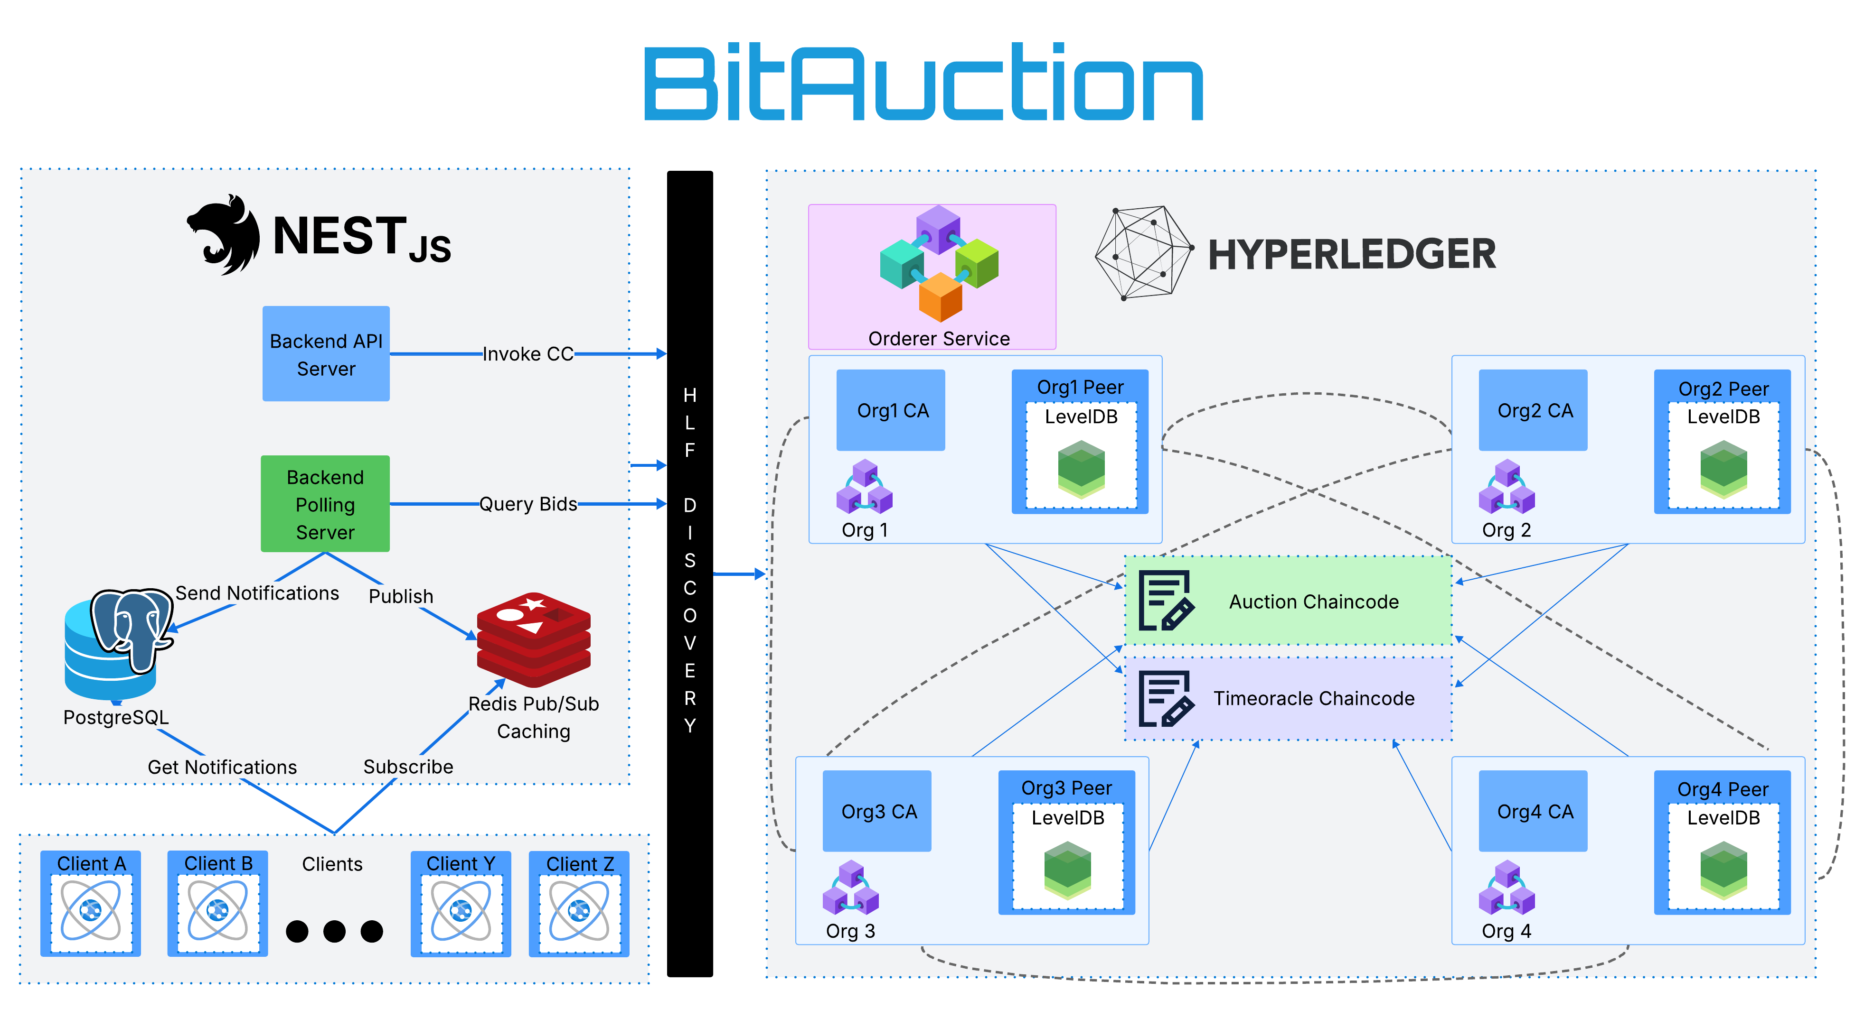
7.2 Architecture Overview
Fig. 7. BitAuction Architecture Overview

Slide 73
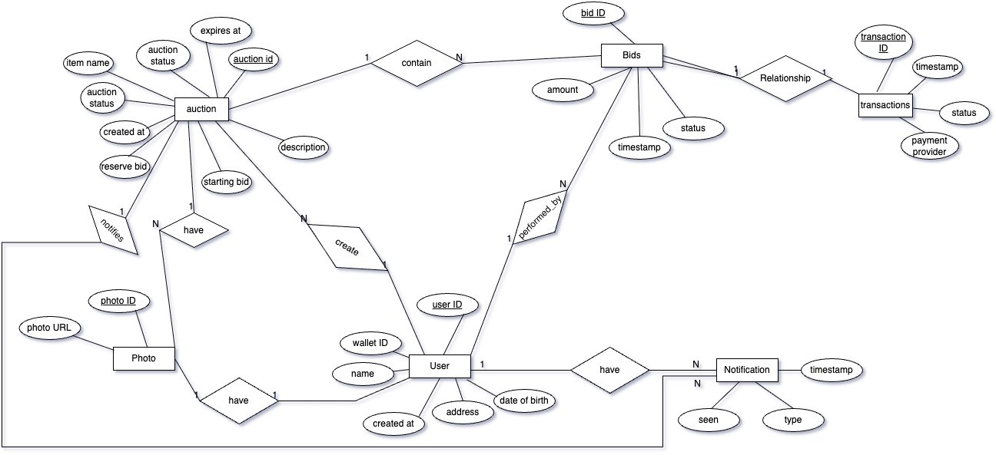
7.3 Database Design
Fig. 8. Database entity relation diagram

Slide 74
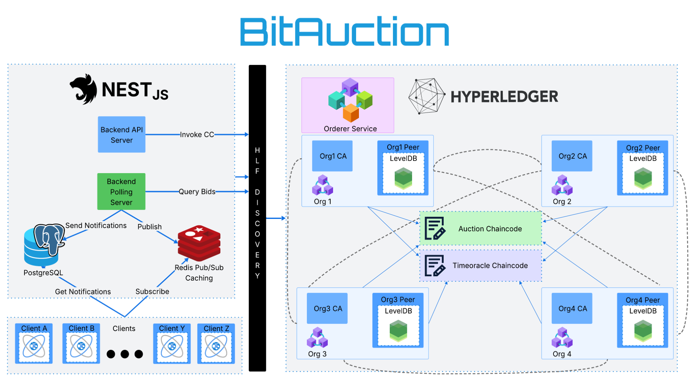

Slide 76
7.4.1 Live Auction Feature
Messaging system
It is a core component in the live auction feature as It offers real-time bid delivery to all active bidders as soon as a new bid is received.
Why Redis?
In-memory datastore → ensures low latency and high throughput.
Ideal for transient messaging needs.
If a bidder is offline, they'll retrieve updates via a read request upon reconnection.

Slide 77
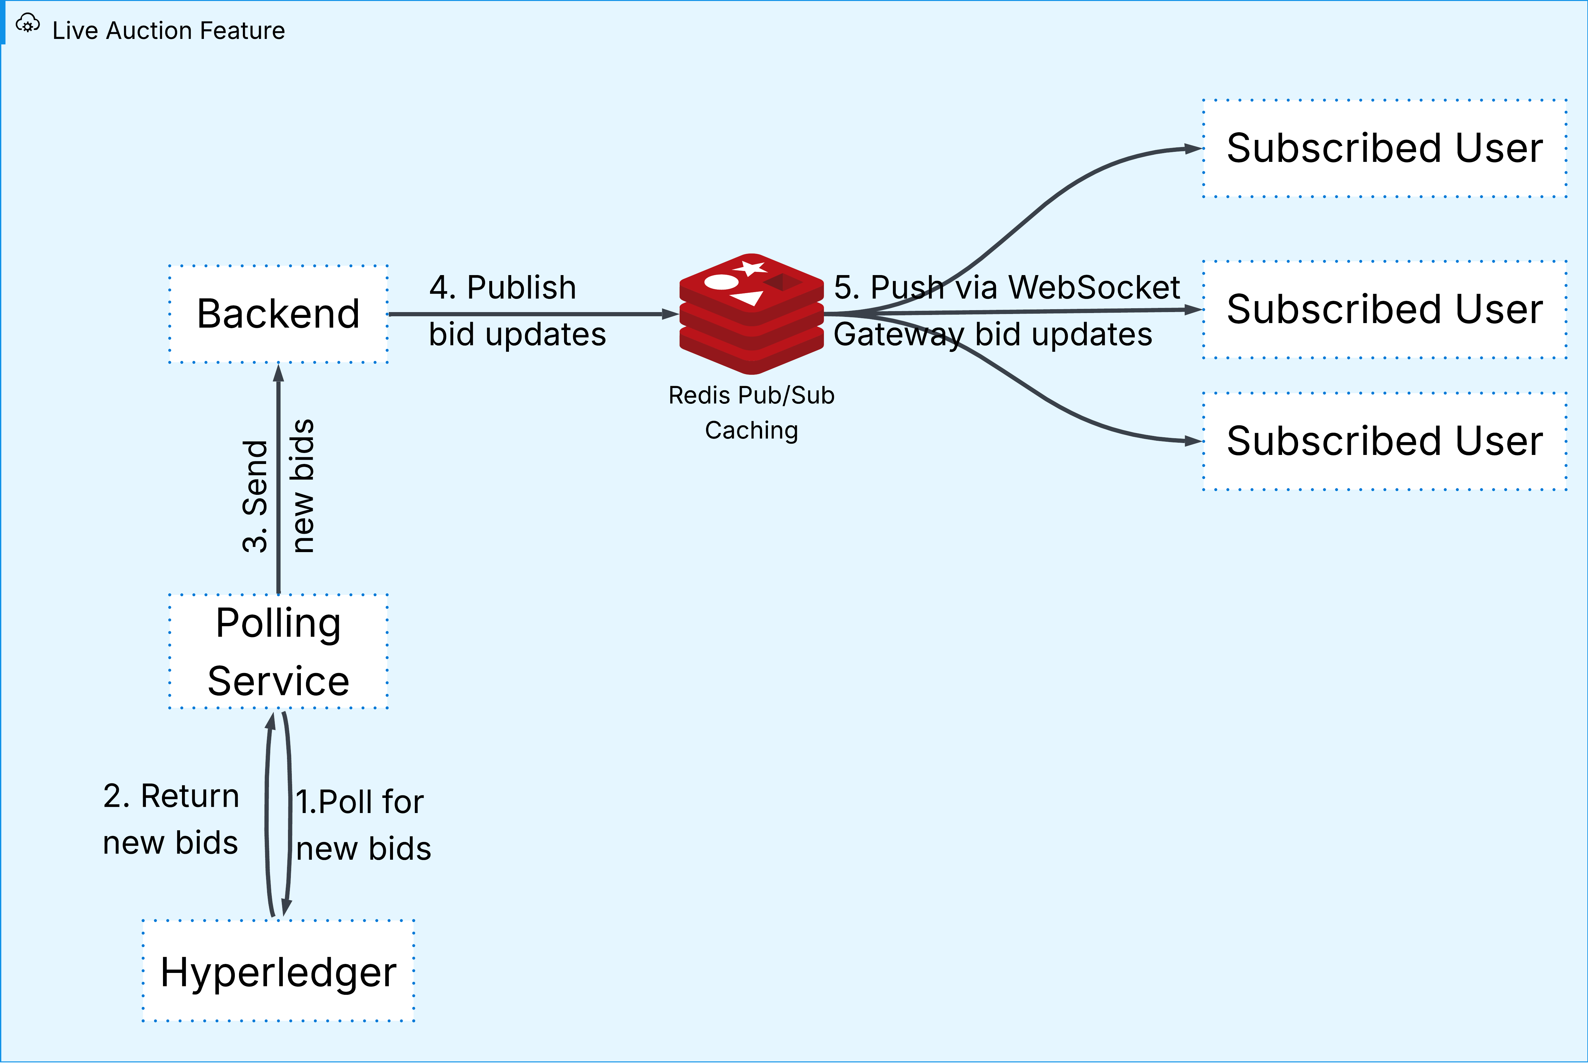
7.4.1 Live Auction Feature
Fig. 9. Live Auction Feature

Slide 78
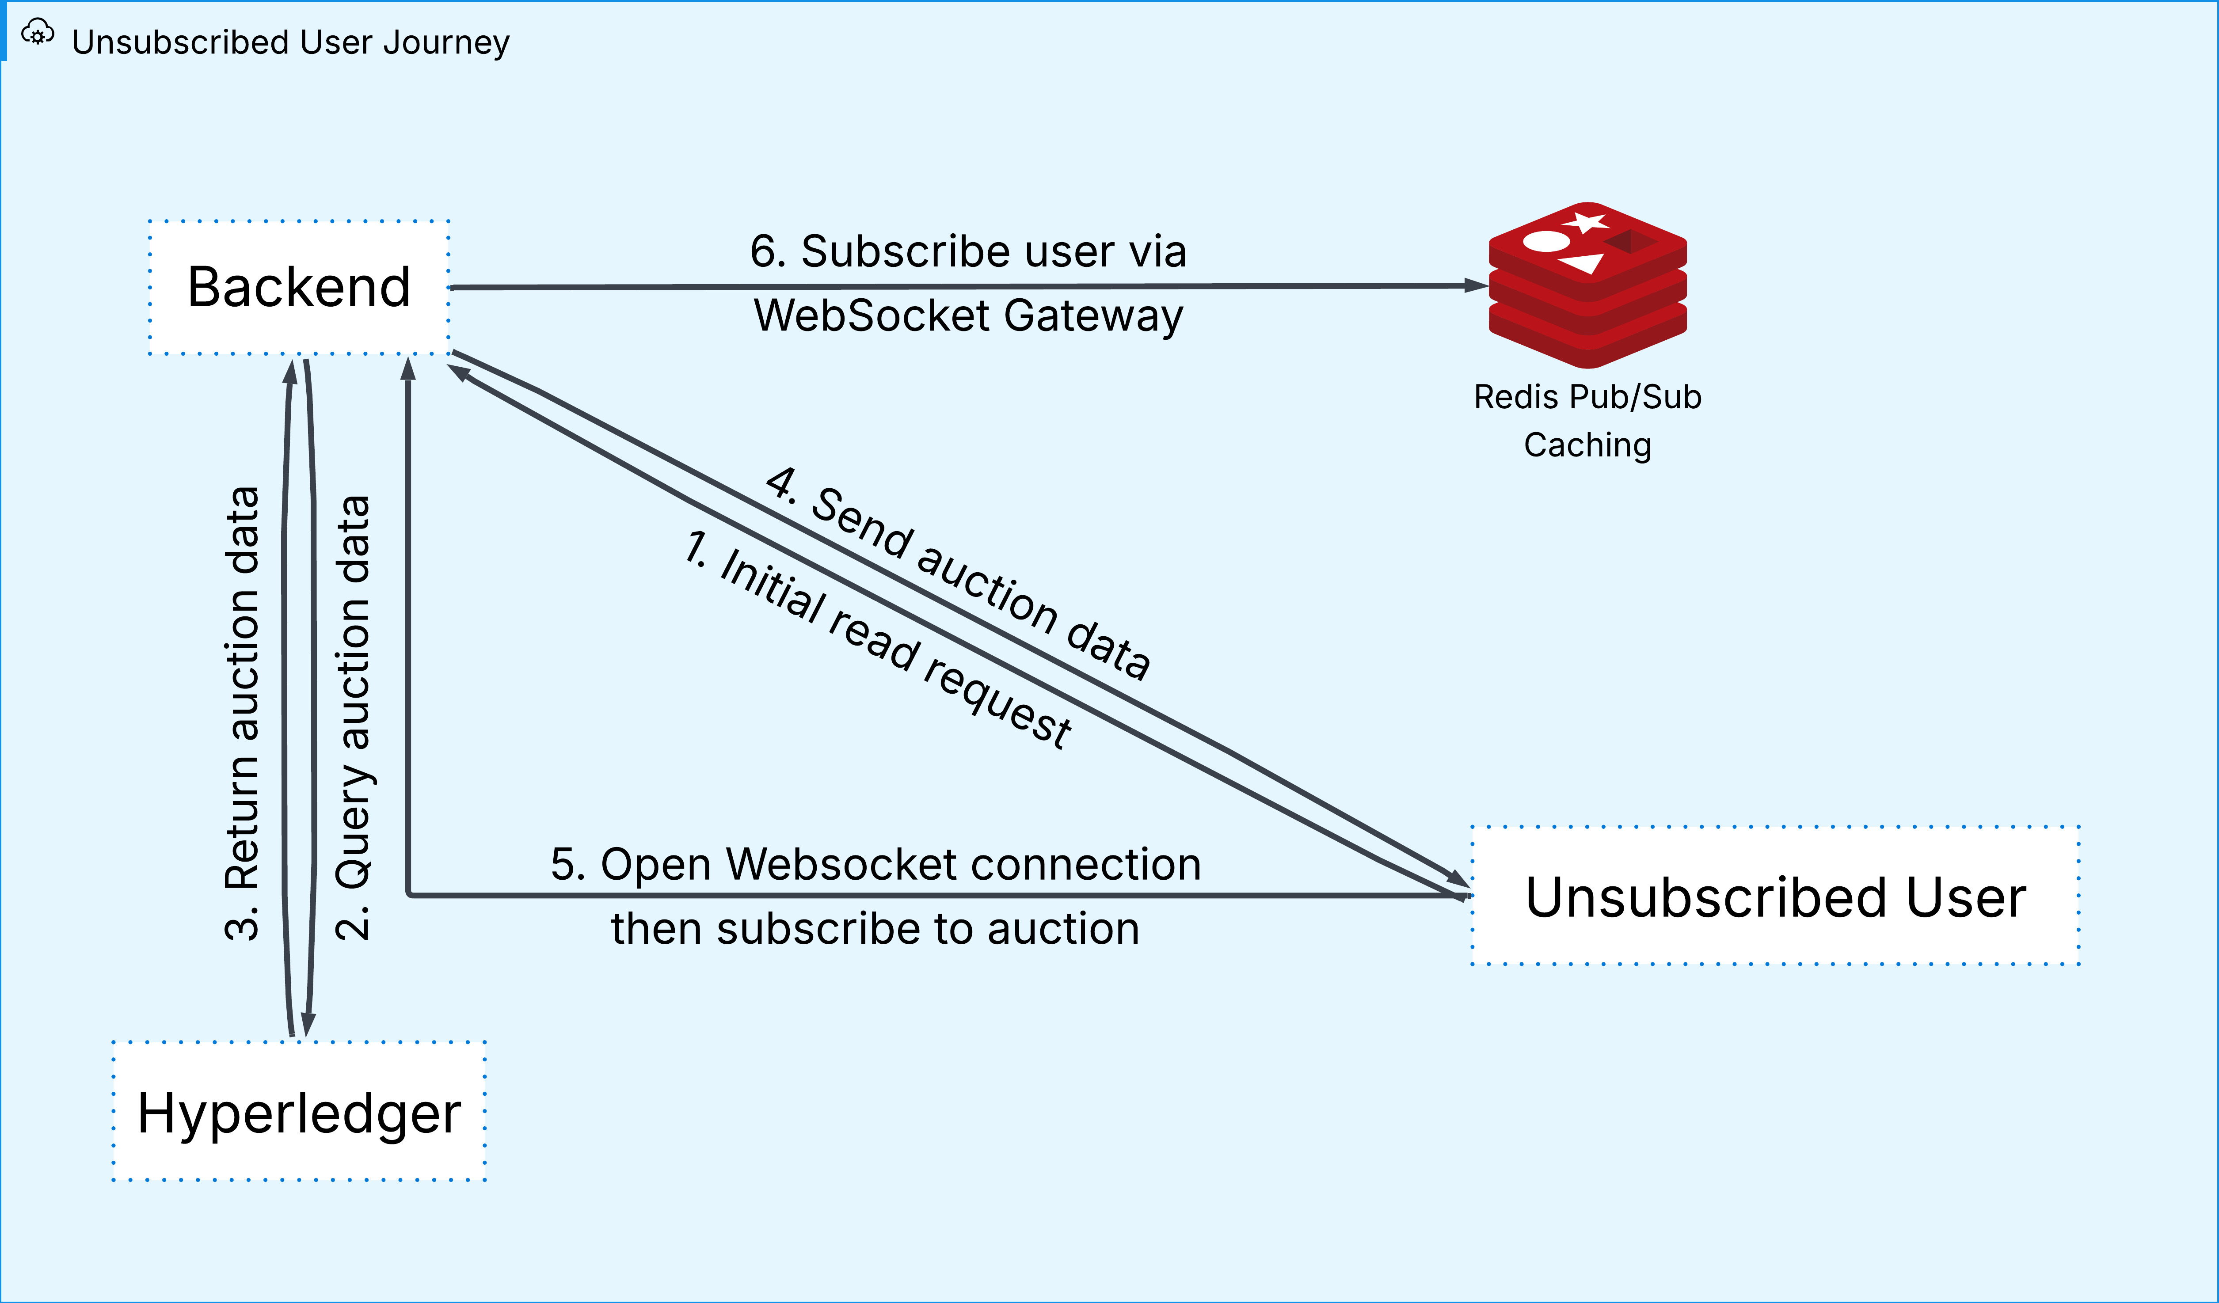
7.4.1 Live Auction Feature
Fig. 10. Unsubscribed User Journey

Slide 80
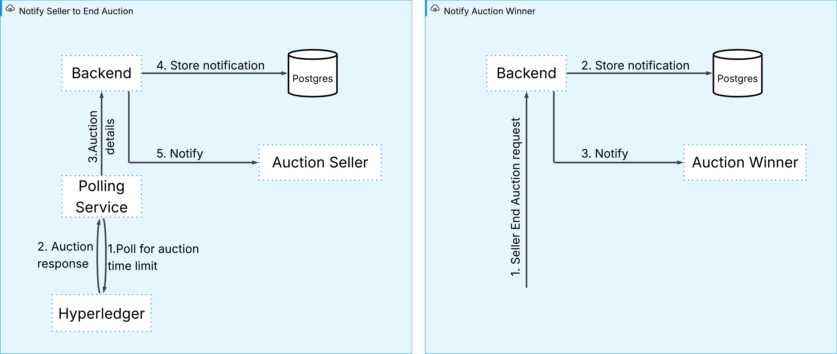
7.4.2 Notifications
Fig. 11. End-of-Auction Notification Workflow

Slide 82
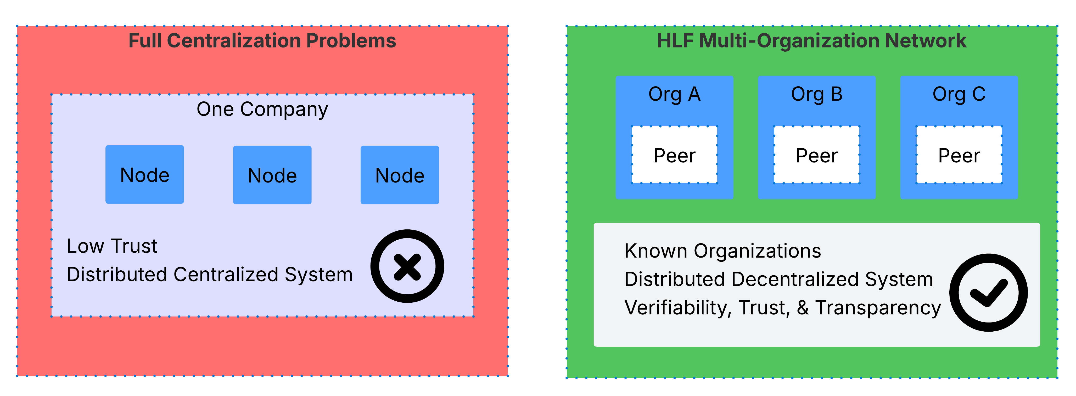
7.5.1 HLF: Enterprise Blockchain Architecture
Fig. 12. HLF enterprise blockchain architecture

Slide 83
7.5.1 HLF: Enterprise Blockchain Architecture
Why use a permissioned network like HLF?
All nodes are known and identified
Organizations must be invited to join
Certificate Authorities (CAs) mange IDs

Slide 84
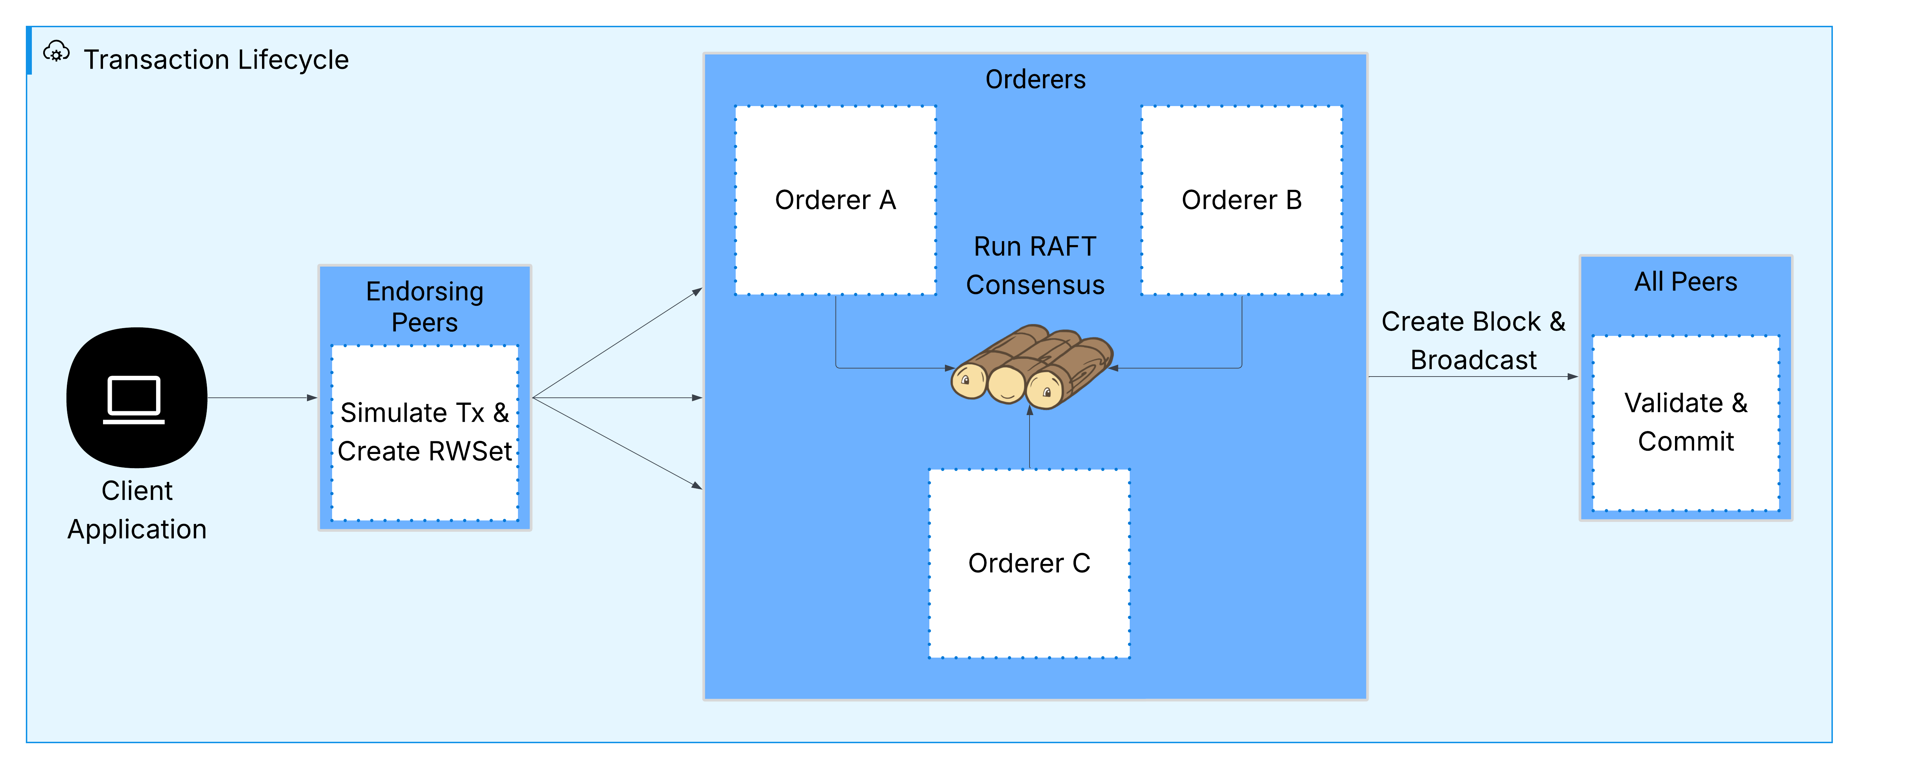
7.5.2 HLF: Transaction Lifecycle
Fig. 13. HLF transaction lifecycle

Slide 85
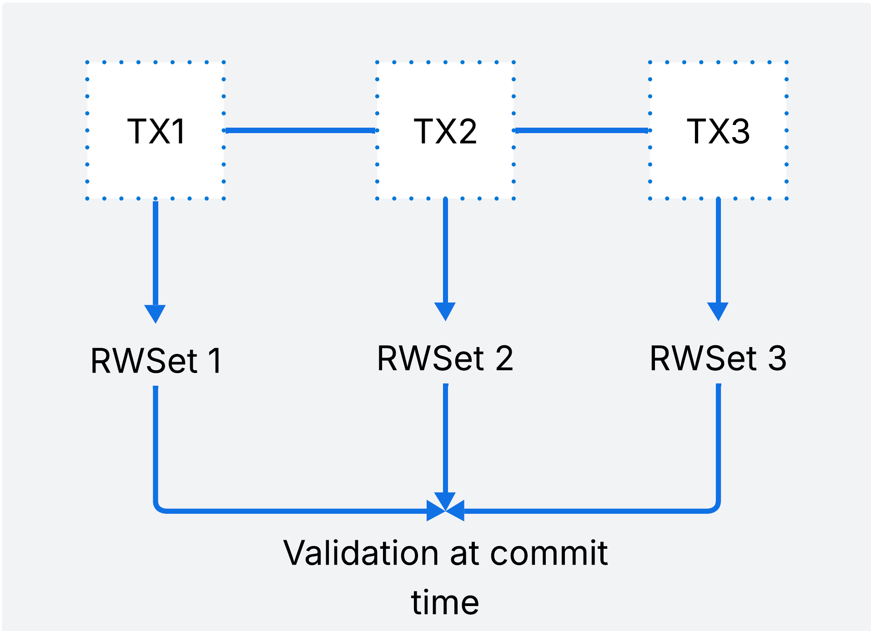
7.5.2 HLF: Transaction Lifecycle
HLF uses Multi-Version Concurrency Control (MVCC)
An optimistic lock-free approach to concurrency control
No blocking between Txs.
Parallel Execution.
Eliminate deadlocks and reduces wait time.
Fig. 14. HLF Read-Write conflict issue

Slide 86
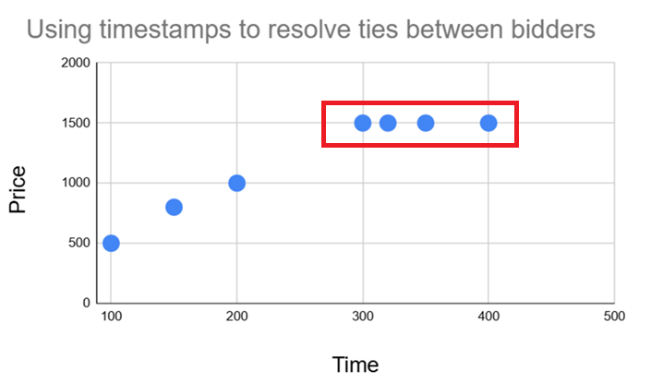
7.5.3 Bidding Protocol
Why is time critical in Open-outcry auctions?
Who wins in this scenario?
Break ties using timestamps
Fig. 15. Ties issue of open-outcry auction model

Slide 87
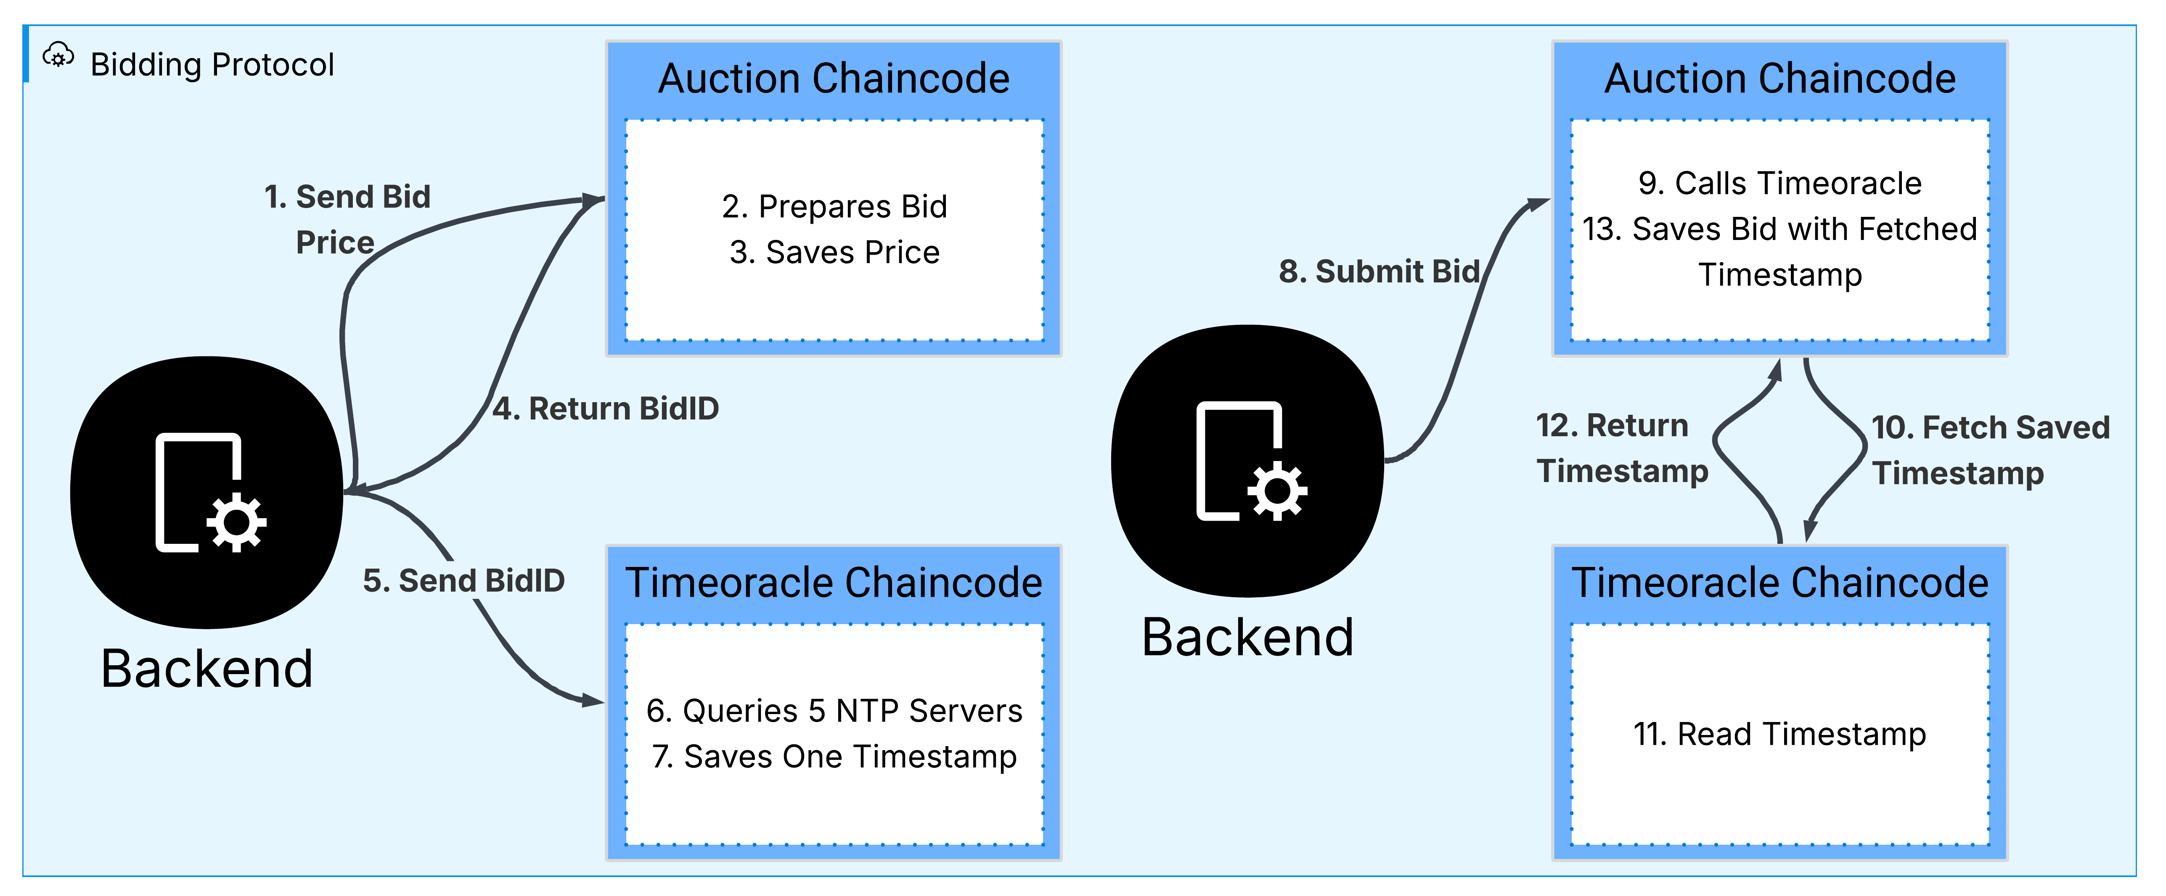
7.5.3 Bidding Protocol
Fig. 16. Bidding protocol

Slide 88
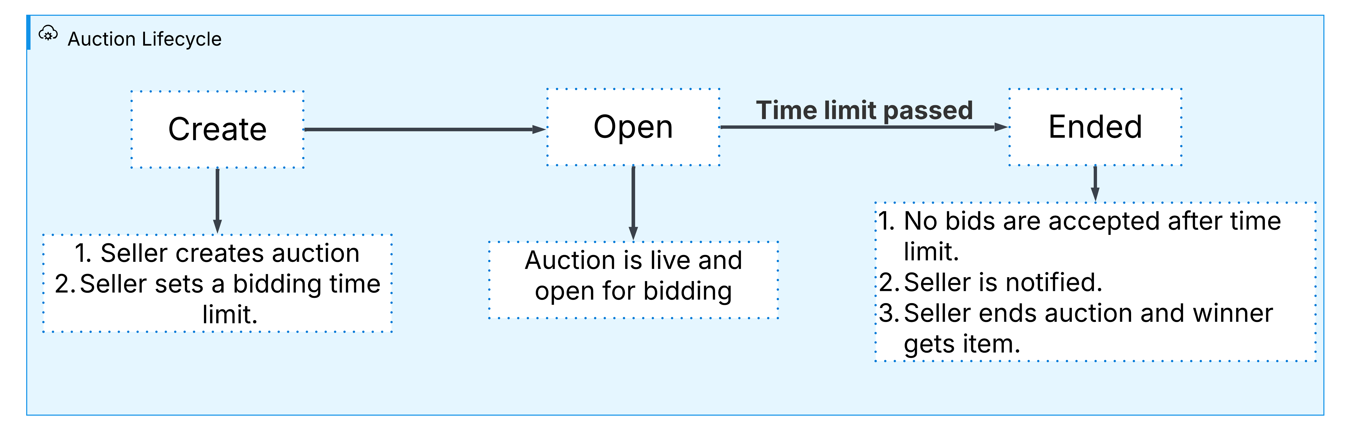
7.5.4 Auction state lifecycle
Fig. 17. Auction state lifecycle

Slide 89
7.6 Platform and Tools
Backend Technologies:
NestJS Framework.
Modular architecture, TypeScript support, extensive ecosystem
NodeJS Runtime.
High performance, extensive package ecosystem for blockchain.
TypeScript.
Type-safe JavaScript development

Slide 90
7.6 Platform and Tools
Blockchain Technologies:
Hyperledger Fabric
Purpose: Enterprise blockchain framework
Components: Peers, orderers, CAS and chaincode
Fabric SDK For Node.js
Package: fabric-network, fabric-ca-client
Purpose: Blockchain interaction from Node.js
Benefits: High-level APIs, connection management

Slide 91
7.6 Platform and Tools
Database Technologies:
PostgreSQL
Purpose: Primary relational database
Benefits: Acid compliance, performance, extensibility
Mainly for search queries for the available auctions.
TypeOrm
Purpose: Object-Relational Mapping
Benefits: Type-safe database operations, migrations

Slide 92
7.6 Platform and Tools
Real-time & Caching Technologies(live auction):
Redis
Purpose: Pub/Sub messaging, caching
Benefits: High Performance, scalability
Socket.IO
Purpose: Real-time WebSocket communication
Benefits: Cross-platform, fallback mechanisms

Slide 93
7.6 Platform and Tools
Development Tools:
Docker & Docker Compose.
Purpose: Containerization and orchestration.
Benefits: Consistent environments, easy deployment
Jira.
Purpose: Project Tracking.
Benefits: Easy to use and monitor team performance.

Slide 94
Agenda
What is a blockchain-based auction system?
Why build a blockchain-based auction system?
Background
Related work
Need to extend related work
Scope of work
Development Process, Environment and Tools
8. Implementation
9. Results
10. Conclusion and Future Work

Slide 95
8 Implementation
8.1 Chain Code Implementation
8.2 Features

Slide 96
8.1 Chain Code Implementation
Auction Chain code: Handles all auction-related functionality including auction creation, bid submissions, winner determination, and auction closure.
Time oracle Chain code: Provides trusted, synchronized timestamps using NTP servers, ensuring fairness in time-sensitive operations like auction closing.

Slide 97
8.2 Features
8.2.1 Signup & Login
8.2.2 Create an auction
8.2.3 Show seller's auctions
8.2.4 Show auction details
8.2.5 Submit bid
8.2.6 Show highest bid & live streaming
8.2.7 Show notifications
8.2.8 End auction

Slide 98
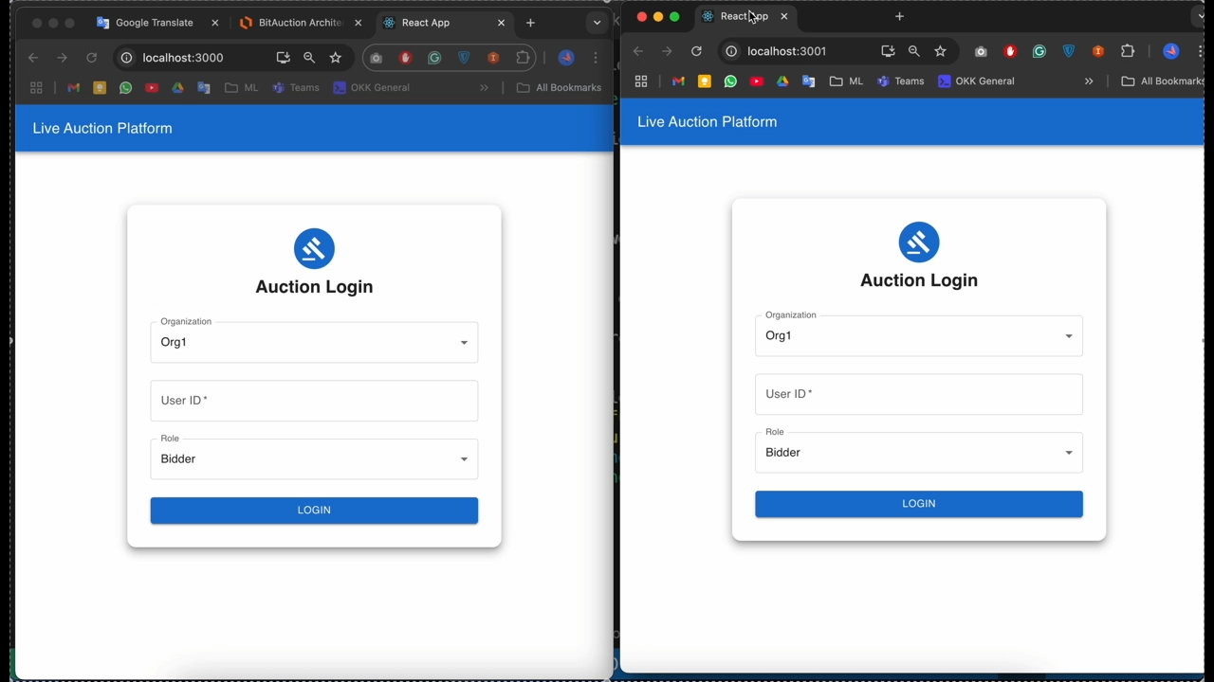
8.2 Demo

Slide 99
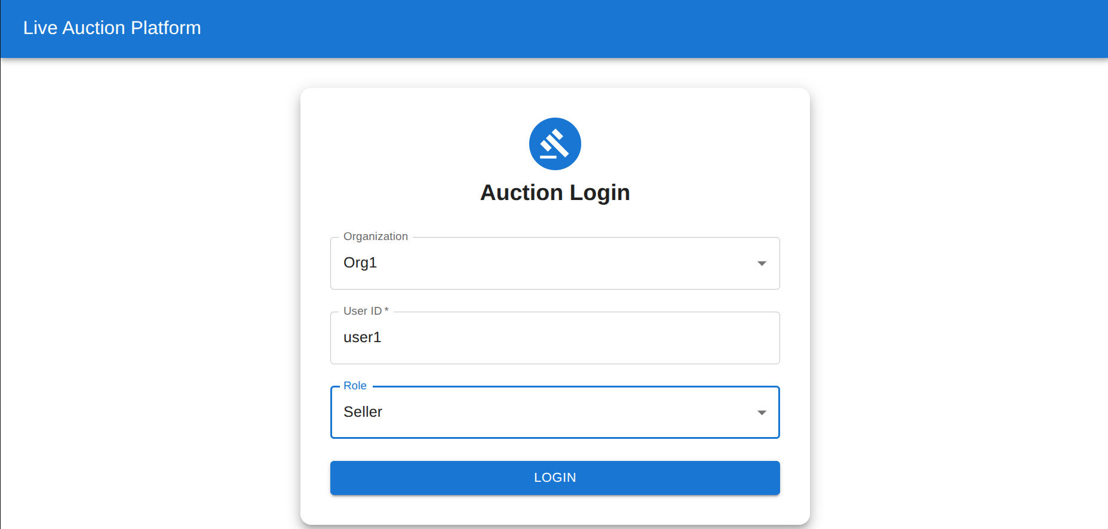
8.2.1 Signup & Login
Fig. 18. Signup and Login in BitAuction

Slide 100
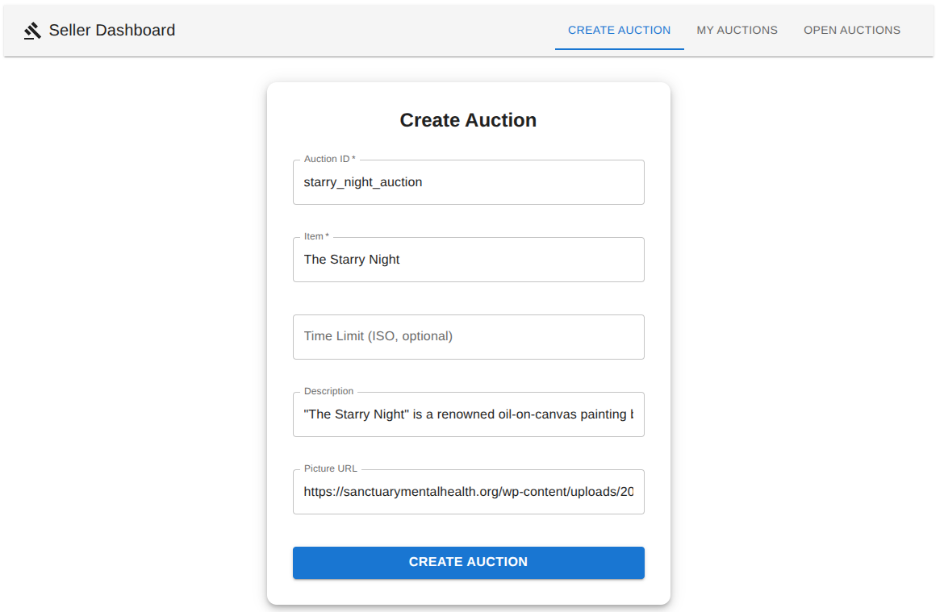
8.2.2 Create an auction
Fig. 19. Create auction in BitAuction

Slide 101
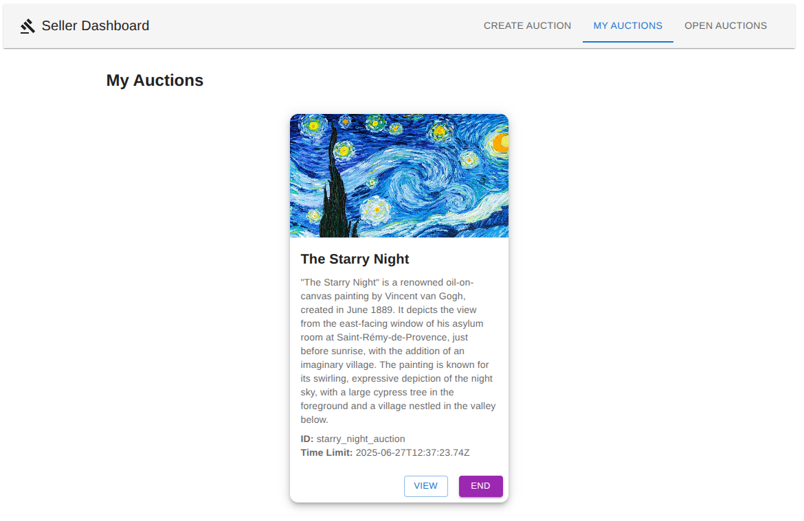
8.2.3 Show seller's auctions
Fig. 20. Showing seller’s auction in BitAuction

Slide 102
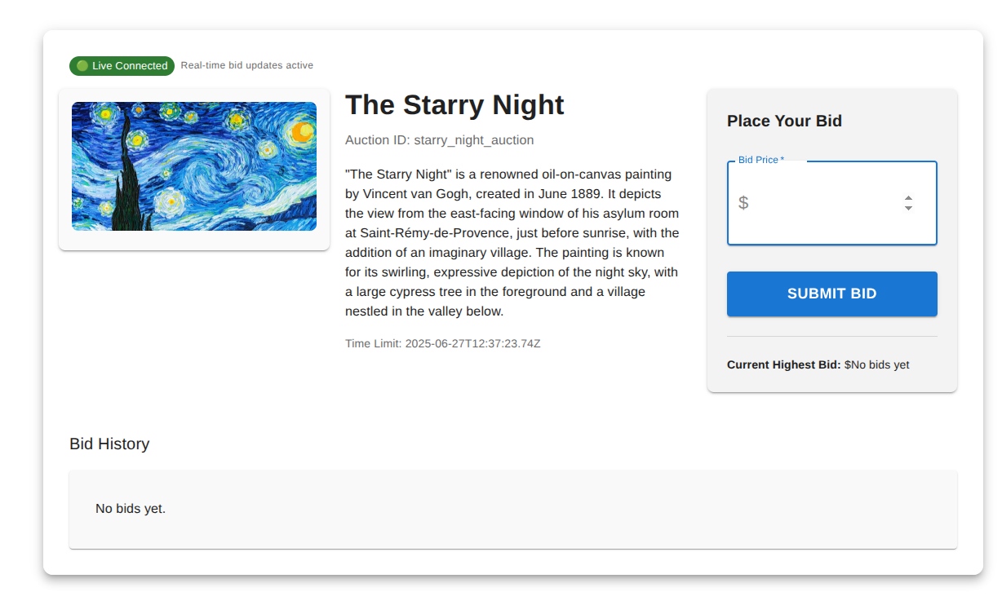
8.2.4 Show auction details
Fig. 21. Showing auction details in BitAuction

Slide 103
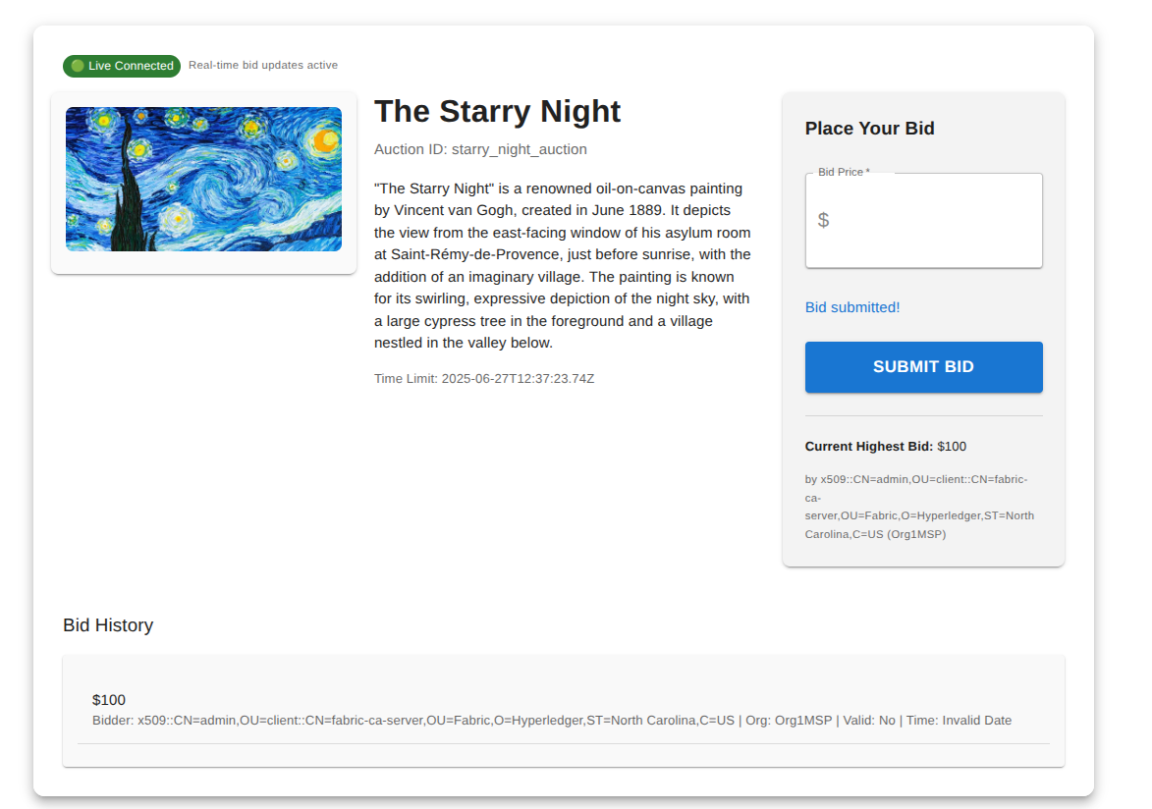
8.2.5 Submit bid
Fig. 22. Submit bid in BitAuction

Slide 104
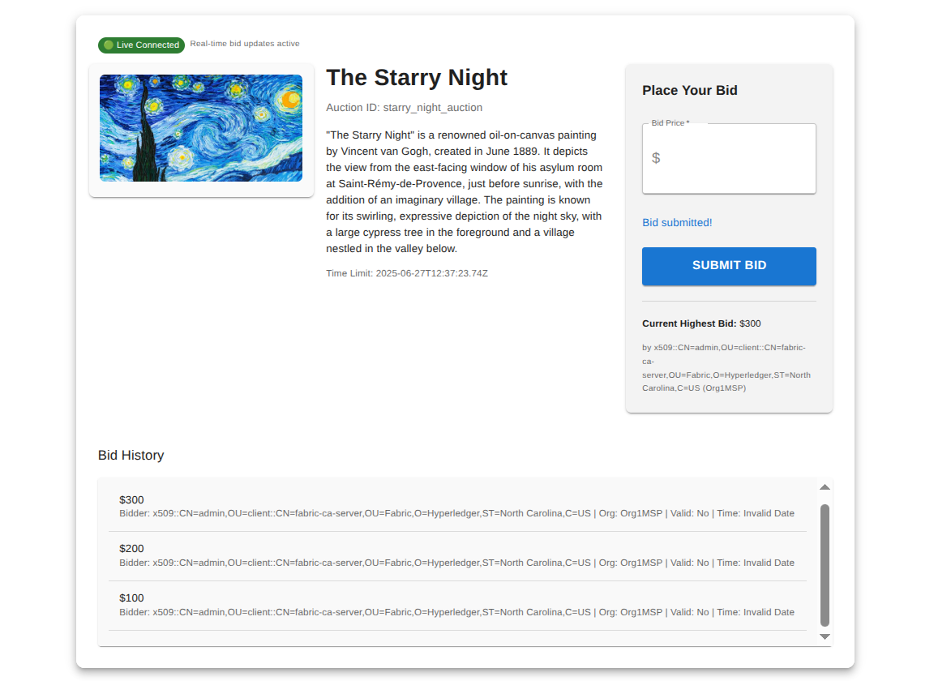
8.2.6 Show highest bid & live streaming
Fig. 23. Showing highest bid and live streaming in BitAuction

Slide 105
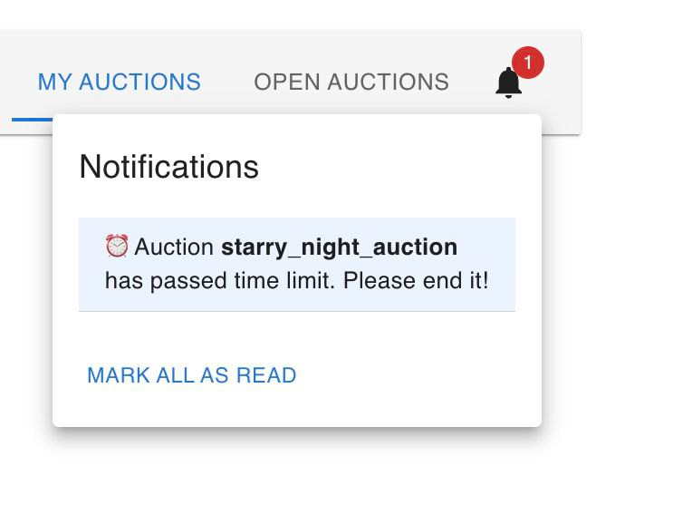
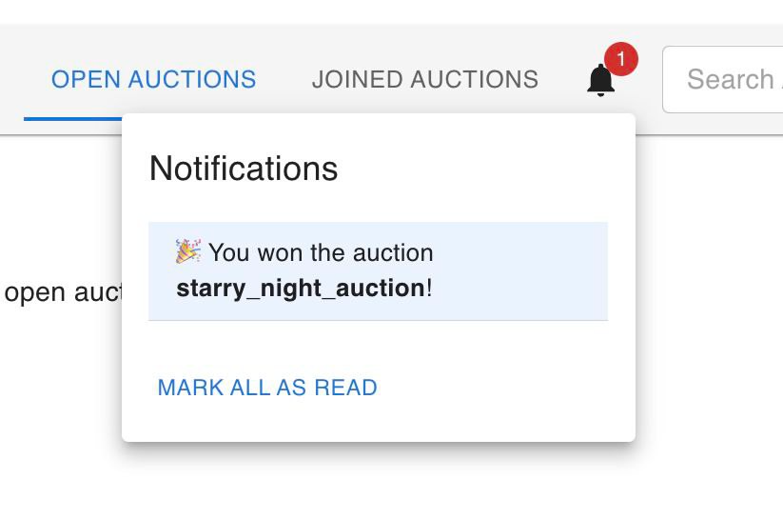
8.2.7 Show Notifications
Fig. 24. Notification system in BitAuction

Slide 106
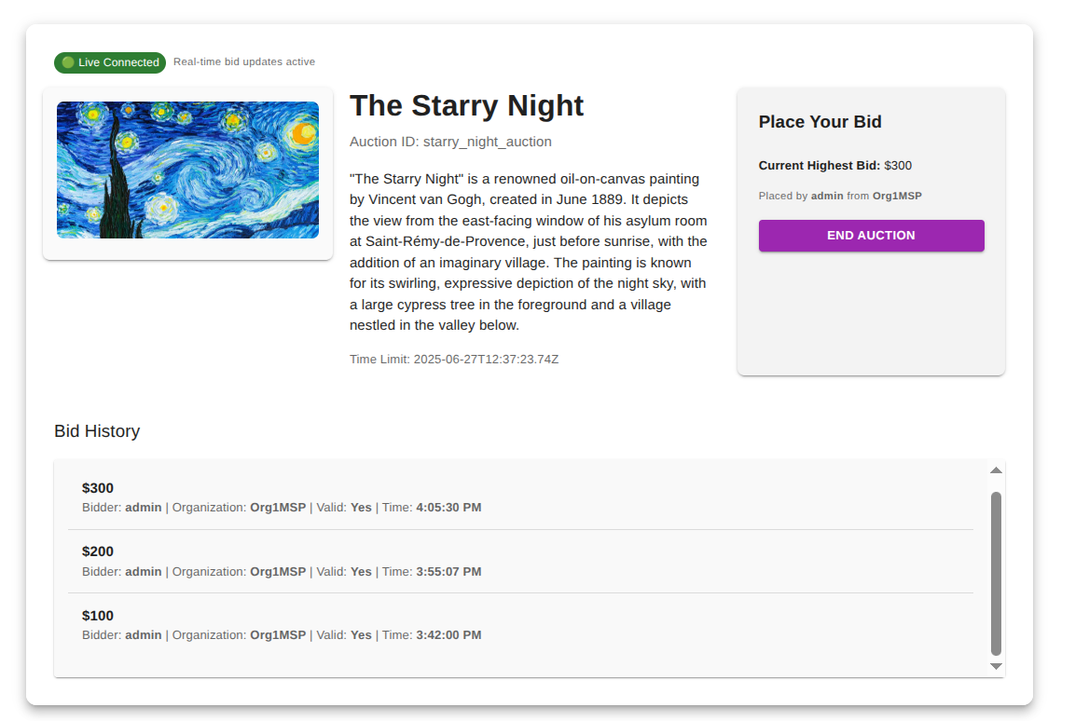
8.2.8 End auction
Fig. 25. End auction in BitAuction

Slide 107
Agenda
What is a blockchain-based auction system?
Why build a blockchain-based auction system?
Background
Related work
Need to extend related work
Scope of work
Development Process, Environment and Tools
Implementation
Results
Conclusion and Future Work

Slide 108
9 Results
9.1 Hyperledger Explorer
9.2 NTP server Testing
9.3 Performance Testing
9.4 Results
9.4.1 Baseline Results
9.4.2 Final Results
9.5 Discussions
9.6 Recommendations

Slide 109

9.1 Hyperledger Explorer
As part of the project, we integrated Hyperledger Explorer, a powerful tool that provides real-time visibility into the blockchain network to showcase:
Live Transaction Tracking: Visualization of all transactions occurring on the network.
Block Details: Inspection of block details, including block height, hash, and timestamp.

Slide 110
9.1 Hyperledger Explorer
Network Insights: Overview of peers, orderers, and Chain codes (smart contracts) installed on the network.
This setup allowed us to validate the integrity of our system, ensuring that:
Every bid is securely recorded on the blockchain.
No tampering or manipulation of auction data is possible.
The system maintains full transparency for authorized participants.

Slide 111
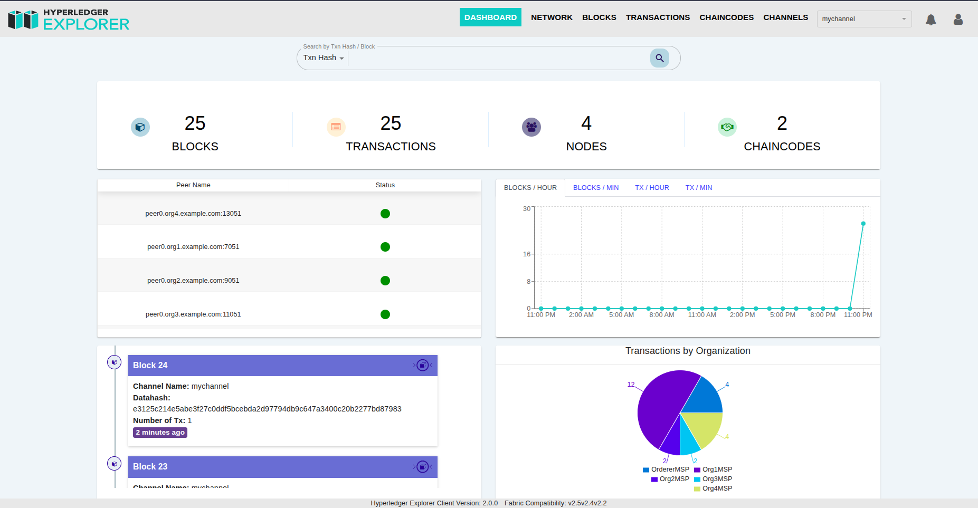
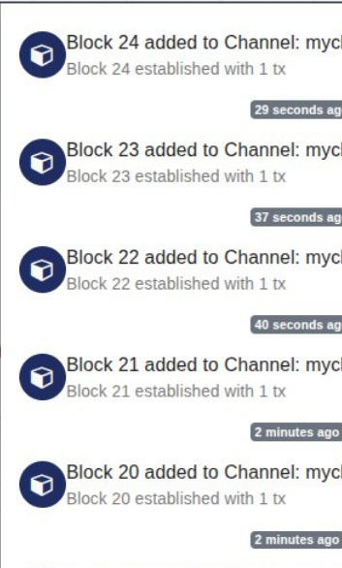
9.1 Hyperledger Explorer
Fig. 26. Hyperledger Explorer

Slide 112
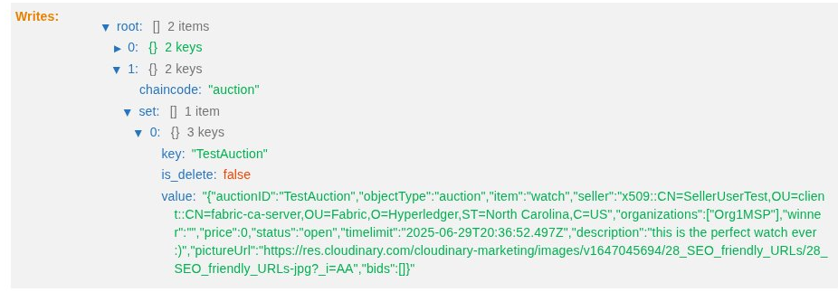


9.1 Hyperledger Explorer
Fig. 27. Create Auction Block

Slide 113
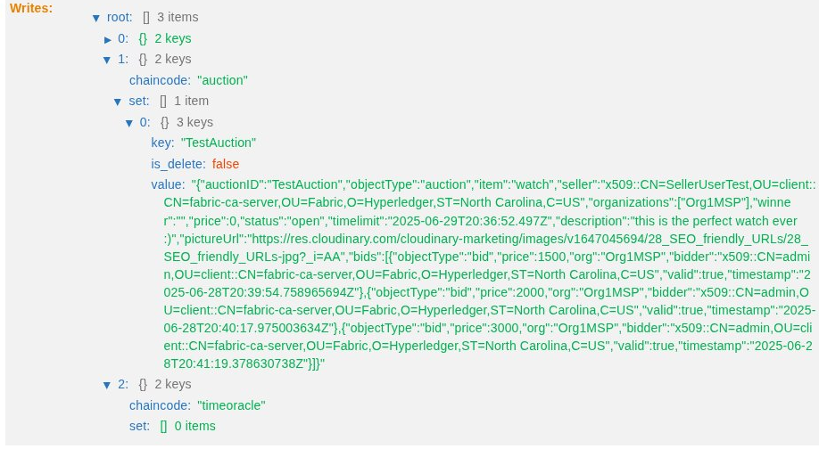
9.1 Hyperledger Explorer
Fig. 28. Bid Block

Slide 114
9.2 NTP Server Testing
To assess the precision, and uniqueness of timestamps provided by NTP servers when handling high levels of concurrent requests.
A stress test was performed using JMeter, configured with 200 concurrent threads to simulate heavy load. The test included a 40-second ramp-up period to gradually introduce the load, and the system operated for a total of 10 minutes, retrieving timestamps from the NTP servers.

Slide 115
9.2 NTP Server Testing
The time difference between successive timestamps ranged from 118 microseconds (118,082 ns) to 621 microseconds (621,054 ns). These variations remained within an acceptable range, highlighting the servers' ability to consistently provide highly precise timestamps under load.
The results demonstrate that even under significant concurrent load, the NTP servers maintained high accuracy and uniqueness of timestamps. This level of precision is crucial for our system.

Slide 116
9.3 Performance Testing
Conducted using JMeter to evaluate system performance under load, Invoked Operations are in those javascript files that connect to the Hyperledger network:
Bid.js and SubmitBid.js: perform some bids (include read and write operations).
QueryAllBids.js: Retrieves all the bids for a certain auction.
TestWriteData.js: Create an object and save it in the state (ledger) of the blockchain.

Slide 117
9.3 Performance Testing
Our Testing environment were conducted on a single machine using the Hyperledger network including the following:
4 Organizations.
4 Peer nodes and 1 Orderer node.
2 Chain codes deployed on each peer node.
Blockchain parameters, including block max message count, block timeout, and block size, were tuned on our machines to achieve optimal performance.

Slide 118
9.4.1 Baseline Results
 | TestWriteData.js
# Samples | 1,513
Avg. Response Time | 19,655 ms
Error Rate | 0.00 %
Throughput | 4.9 / sec

Slide 119
9.4.2 Final Results
 | Bid.js | SubmitBid.js | Total
# Samples | 750 | 702 | 1452
Avg. Response Time | 20,381 ms | 20,945 ms | 20,653 ms
Error Rate | 0.00 % | 0.00 % | 0.00 %
Throughput | 2.4 / sec | 2.2 / sec | 4.6 / sec

Slide 120
9.4.2 Final Results
 | QueryAllBids.js
# Samples | 18,999
Avg. Response Time | 1,523 ms
Received KBs | 34.84 KB / sec
Error Rate | 0.00 %
Throughput | 63.3 / sec

Slide 121
9.5 Results Discussion
Write Operations Performance:
Files TestWriteData.js. Bid.js, and SubmitBid.js showed high response time on average, these operations involve writing data to the blockchain ledger, which naturally introduces delays due to consensus mechanisms and state validation.
The Throughput for write operations remains low, around 2.2 to 2.4 operations per second, reflecting the expected overhead in blockchain-based write transactions.

Slide 122
9.5 Results Discussion
Read Operations Performance:
QueryAllBids.js, responsible for retrieving all bids, demonstrated significantly better performance with an average response time of 1.5 seconds.
The Throughput for read operations are higher than write operations, around 63.3 operations per second, indicating that read-heavy workloads are processed efficiently compared to write operations.

Slide 123
9.5 Results Discussion
The system exhibits acceptable performance for read-intensive operations, but write operations remain a bottleneck, typical for permissioned blockchain networks like Hyperledger Fabric.
These results establish a baseline for evaluating any subsequent improvements or optimizations to the system.

Slide 124
9.6 Recommendations
Block Size Tuning by adjusting batch size and batch timeout for better batching and reduced block generation delay.
Network Configuration Tuning by increasing the number of Orderer Nodes for better fault tolerance and performance (subject to hardware availability).
Testing on high-performance machines recommended for accurate production-grade benchmarking.

Slide 125
Agenda
What is a blockchain-based auction system?
Why build a blockchain-based auction system?
Background
Related work
Need to extend related work
Scope of work
Development Process, Environment and Tools
Implementation
Results
10.Conclusion and Future Work

Slide 126
10 Conclusion and Future Work
10.1 Conclusion
10.2 Contribution of the project
10.3 Future work

Slide 127
10.1 Conclusion
Developed a blockchain-based auction system for secure and transparent bidding
Addressed tie-breaking challenge using an external time oracle with multiple distributed NTP servers
Implemented an open outcry auction model to mimic real-world auction dynamics
Delivered a user-friendly platform ensuring accessibility and transparency

Slide 128
10.2 Contribution of the project
Open Source Release The entire system is publicly available on GitHub to encourage transparency, collaboration, and future research.
SPI Model Adoption Followed the Software Process Improvement (SPI) model to ensure a structured, iterative, and quality-focused development lifecycle.

Slide 129
10.2 Contribution of the project (Cont’d)
Open Outcry Auction Model Implemented a transparent and competitive bidding mechanism where participants can view and respond to real-time bids.
Live Auction Interface Built a dynamic, real-time auction interface enabling seamless user participation and bid tracking.

Slide 130
10.2 Contribution of the project (Cont’d)
User-Centric UI Design Designed with accessibility and ease-of-use in mind to enhance user experience across different skill levels.
Tie-Breaking Time Protocol Developed a reliable tie-breaking solution using synchronized timestamps from multiple distributed NTP servers to ensure fairness and precision.

Slide 131
10.3 Future Work
Future work aims to enhance the auction system by addressing scalability, integration, and user-centric features to ensure robust functionality and seamless operation in real-world environments.
Auction payment with cryptocurrency: The integration of cryptocurrency as a payment method will enable secure and decentralized transactions. (8)

Slide 132
10.3 Future Work (Cont’d)
Try promising auction scalability solutions to address potential bottlenecks in high-demand scenarios. (9)
Use FastFabric as an Underlying System: Leveraging FastFabric as the foundational blockchain system will enhance the overall efficiency of the auction platform. (14)

Slide 133
10.3 Future Work (Cont’d)
Support Personalized Recommendations: Enhance the user experience by suggesting auction items based on user preferences and browsing history. (16)
Price Prediction on Auction Items: Provide users with actionable insights into expected auction outcomes. By leveraging historical data and deep learning techniques. (17)

Slide 134
10.3 Future Work (Cont’d)
Support multiple auction models such as English, Dutch, or sealed-bid auctions dynamically.
Adopt Network Time Security (NTS) instead of NTP to obtain cryptographically secure and tamper-resistant timestamps for submitted bids, enhancing the integrity of the tie-breaking mechanism.

Slide 135
10.3 Future Work (Cont’d)
Develop a user-friendly blockchain explorer tailored for non-technical users, providing an intuitive alternative to the Hyperledger Fabric Explorer, which typically requires an engineering background to navigate.
Fraud Detection and Attack Simulation: Conduct comprehensive tests to evaluate the system's resistance to fraudulent activities.

Slide 136
10.3 Future Work (Cont’d)
Consensus Algorithm Benchmarking: Compare between our work and other systems that use compute-intensive consensus algorithms.
Incorporate Cristian’s Algorithm: Integrate Cristian’s algorithm into the time synchronization module to estimate and account for network latency

Slide 137
10.3 Future Work (Cont’d)
Dynamic Time Limit Extension: Enhance the auction logic by allowing automatic time limit extensions when bids are placed shortly before the auction’s scheduled end

Slide 138
Thank you for attending!
Any Questions?

Slide 139
References
[1]: Shi, Z., De Laat, C., Grosso, P., & Zhao, Z. (2022). Integration of blockchain and auction models: a survey, some applications, and challenges. IEEE Communications Surveys & Tutorials, 25(1), 497–537. https://doi.org/10.1109/comst.2022.3222403
[2]: Chiquito, E., Bodin, U., & Schelén, O. (2023). Survey on decentralized auctioning systems. IEEE Access, 11, 51673–51688. https://doi.org/10.1109/access.2023.3279914
[3]: Chiquito, E., Bodin, U., Schelén, O., & Monrat, A. a. A. (2024). Digitalized and Decentralized Open-Cry Auctioning: key properties, solution design, and implementation. IEEE Access, 12, 64686–64700. https://doi.org/10.1109/access.2024.3395791
[4]: Wust, K. and Gervais, A. (2018) “Do you need a blockchain?”, 2018 Crypto Valley Conference on Blockchain Technology (CVCBT), pp. 45–54. doi:10.1109/cvcbt.2018.00011.
[5]: Inpher, Inc. (2024b, February 20). What is Secure Multiparty Computation? - SMPC/MPC Explained | Inpher. Inpher. https://inpher.io/technology/what-is-secure-multiparty-computation/

Slide 140
References
[6]: Li, Honglei, and Weilian Xue. "A Blockchain-Based Sealed-Bid e-Auction Scheme with Smart Contract and Zero-Knowledge Proof." Security and Communication Networks 2021 (2021): Article ID 5523394. https://doi.org/10.1155/2021/5523394.
[7]: Tan, S., & Heng, S. (2022). Secure cryptographic E-Auction system. International Journal of Technology, 13(6), 1222. https://doi.org/10.14716/ijtech.v13i6.5827
[8]: Omar, I. A., Hasan, H. R., Jayaraman, R., Salah, K., & Omar, M. (2021). Implementing decentralized auctions using blockchain smart contracts. Technological Forecasting and Social Change, 168, 120786. https://doi.org/10.1016/j.techfore.2021.120786
[9]: Qusa, H., Tarazi, J., & Akre, V. (2020, February). Secure e-auction system using blockchain: UAE case study. In 2020 Advances in Science and Engineering Technology International Conferences (ASET) (pp. 1-5). IEEE.
[10]: Minaei, M., Le, D. V., Kumaresan, R., Beams, A., Moreno-Sanchez, P., Yang, Y., ... & Zamani, M. (2023). Scalable Off-Chain Auctions. Cryptology ePrint Archive.

Slide 141
References
[11]: H. S. Galal and A. M. Youssef, “Verifiable sealed-bid auction on the Ethereum blockchain,” in Proc. Int. Conf. FC, Nieuwpoort, Curaçao, Feb. 2018, pp. 265–278.
[12]: Chow, V. (2020). Predicting auction price of vehicle license plate with deep recurrent neural network. Expert Systems with Applications, 142, 113008.
[13]: "0xAuction", [Online]. Available, link: Apostrophe-Corp/0xAuction: An NFT market place with real time onchain notifications, [Accessed: 12/1/2024]
[14] “Opensea," [Online]. Available: https://opensea.io/, [Accessed: 12/1/2023].
[15] “Rarible," [Online]. Available: https://rarible.com/, [Accessed: 12/1/2023].
[16] "stargaze," [Online]. Available: https://github.com/public-awesome/stargaze, [Accessed: 12/1/2023].
[17] "Liveauctioneers," [Online]. Available: LiveAuctioneers: Online Auctions for Arts, Antiques & Collectibles, [Accessed: 12/1/2023].

Slide 142
References
[18]: Pop, C., Prata, M., Antal, M., Cioara, T., Anghel, I., & Salomie, I. (2020). An Ethereum-based implementation of English, Dutch, and First-price sealed-bid auctions. 2020 IEEE 16th International Conference on Intelligent Computer Communication and Processing (ICCP), https://doi.org/10.1109/ICCP51029.2020.9266180
[19]: Gorenflo, C., Lee, S., Golab, L., & Keshav, S. (2020). FastFabric: Scaling hyperledger fabric to 20 000 transactions per second. International Journal of Network Management, 30(5), e2099.
[20]: Proxies - OpenZeppelin Docs. (n.d.). https://docs.openzeppelin.com/contracts/4.x/api/proxy

